Slide 1

FINANCIAL FORECASTING
USING POWER BI

Slide 2
OUR TEAM
PABBA SATHVIKA
JYOTHI SRAVANI
SHALINI SHERYAR
MOUNIKA
MEGHANA

Slide 3

INTRODUCTION
What is Financial forecasting?
Financial forecasting is the process of predicting future financial outcomes using historical data, trends, and patterns.It provides businesses with insights into their potential revenues, expenses, and profitability over a specific period, enabling them to plan and allocate resources effectively.
Key Benefits:
Strategic planning
Risk mitigation
Budgeting and financial management
Market adaptation
Scope:
Revenue trends, profitability analysis, discount impact, and seasonal demand forecasting.
Insights into customer and product performance.
Objectives:
Assess category wise sales.
Evaluate the impact of discounts on profit margins.
Predict seasonal demand..
Understand product and customer segment trends.
Align cost of goods sold (COGS) with profitability.
Analyze and forecast revenue growth.

Slide 4
What is Power BI?
Power BI is a business analytics tool developed by Microsoft that helps users visualize data, derive insights, and make data-driven decisions.
Power BI Features
Developed by Microsoft for data visualization and analysis.
Connects to multiple data sources (Excel, databases, cloud services).
Transforms raw data into clean, usable formats.
Creates interactive reports and dashboards to monitor metrics.
Supports custom calculations using the DAX formula language.
Includes AI tools for deeper insights (like natural language queries).
Allows sharing reports through the Power BI Service (cloud).
Mobile apps for on-the-go access to reports and dashboards.
key features of power BI Desktop app:
1.Data Connectivity
2. Data Transformation and Cleaning
3. Data Modeling
4. Visualizations
5. Custom Visuals
6. Drag-and-Drop Interface
7. Slicers and Filters
8. Advanced Analytics
9. Report Sharing and Collaboration
10. Query Folding
11. Bookmarks and Drillthrough
12. Performance Optimization
13. Scheduled Refresh

Slide 5

DATA PREPARATION
DATA SOURCES:
MasterCustomer1: Key customer details (City, Category, Group, Location).
InvoiceData: Transactional details (Sales, Quantity, YoY Sales).
Financials: Profitability data (COGS, Discounts, Profit).
DATA CLEANING:
InvoiceData:
Merged Day, Month, and Year columns into a single Date column.
Standardized Date data type for compatibility.
Removed unnecessary columns to streamline data.
MasterCustomer1:
Split CityProvince into City and Province.
Retained only relevant columns for analysis.

Slide 6
DATA MODELING
DATA INTEGRATION:
Loaded InvoiceData, MasterCustomer1, and Financials.
Linked tables:
CustomerID (MasterCustomer1 ↔ InvoiceData).
Date (InvoiceData ↔ Financials).
MODELING:
Established accurate relationships across datasets.
Added a Year-over-Year (YoY) Sales Change Measure.
Ensured consistency in relationships and data types for accurate forecasts.

Slide 7
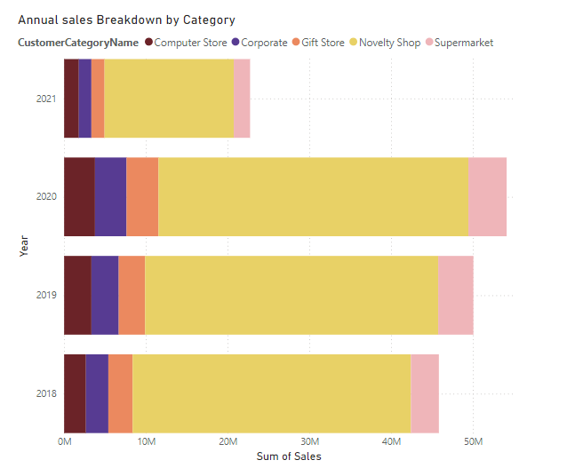
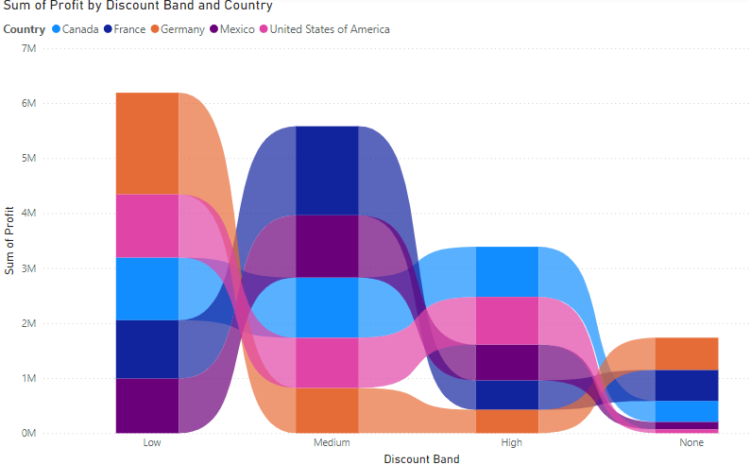
DATA VISUALIZATION
stacked bar chart
Ribbon chart
Category Performance Over Time
Impact of Discounts on Profit
"Novelty Shop" has the highest sales, followed by "Supermarket"; "Computer Store" has the lowest.
Sales have increased over time, especially in 2020
The total profit is highest for the "Low" discount band, followed by "Medium," then "High," and lastly "None."
This suggests that offering lower discounts may lead to higher profit.

Slide 8
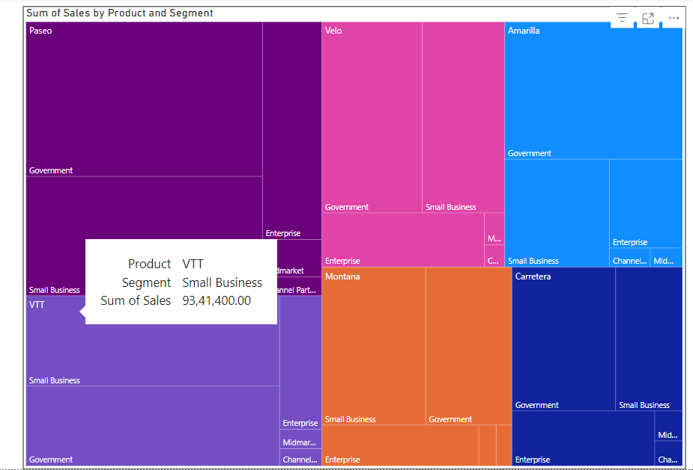
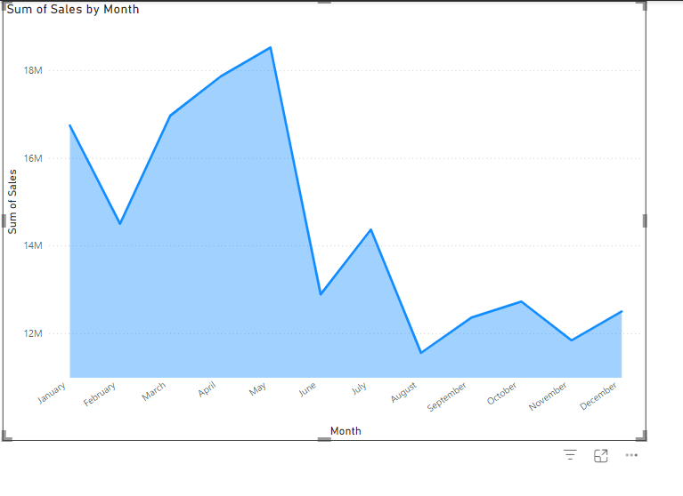
Tree Map
Area Chart
Sales by Product and Segment
Seasonal Demand Forecasting
The top-performing product is VTT with total sales of 93,41,400.00.
The product VTT performs best in the Small Business segment
Focus on the Small Business segment for the VTT product to increase sales further.
Explore new product offerings or market strategies for segments where performance is low.
Sales peak in the months of May and July.
Sales decline in the months of February and August.
Stock Inventory in Advance for Peak Seasons:
Plan Targeted Campaigns During Slow Months

Slide 9
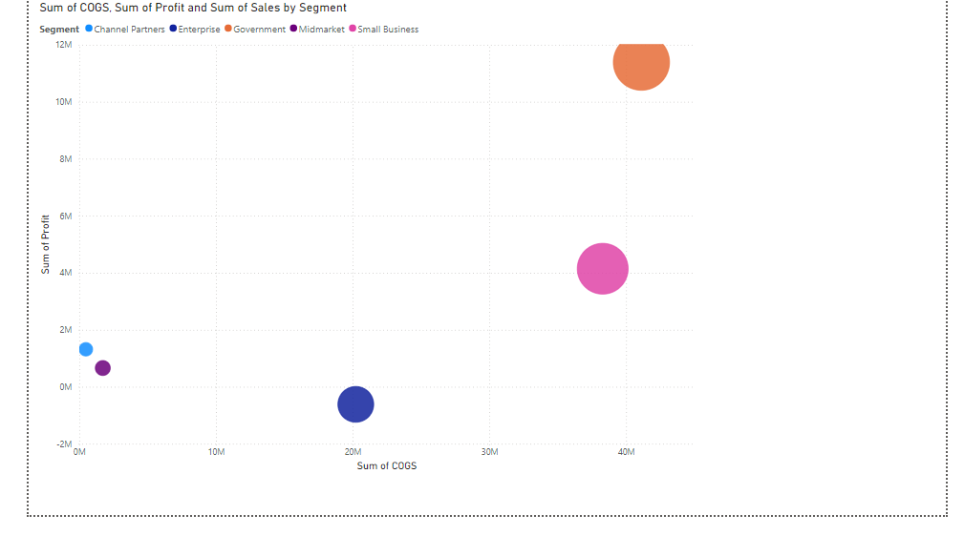
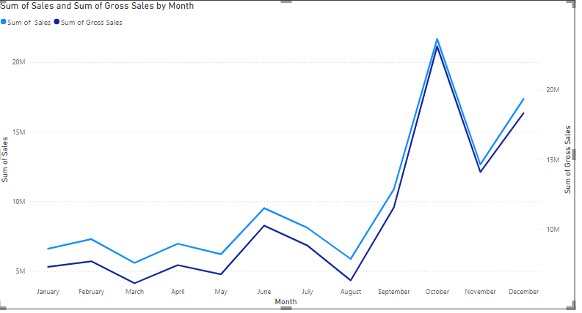
Scatter chart
Line chart
Cost vs. Profit Analysis
Revenue Growth Analysis
The scatter plot can help identify products that have high sales but low profit. By optimizing costs for these items, such as finding cheaper suppliers or improving production efficiency, companies can improve their profitability.
For segments with low margins, companies should analyze their supply chain to identify areas for improvement. This may include reducing transportation costs, negotiating better prices with suppliers, or streamlining internal processes.
Both sales and gross sales generally follow a similar trend with an increase in sales in the months of June and October and a decrease in the months of March and November.
Based on the trend observed, the months of June and October show peak sales. The company can allocate resources and manpower to cater to the high demand during these periods

Slide 10
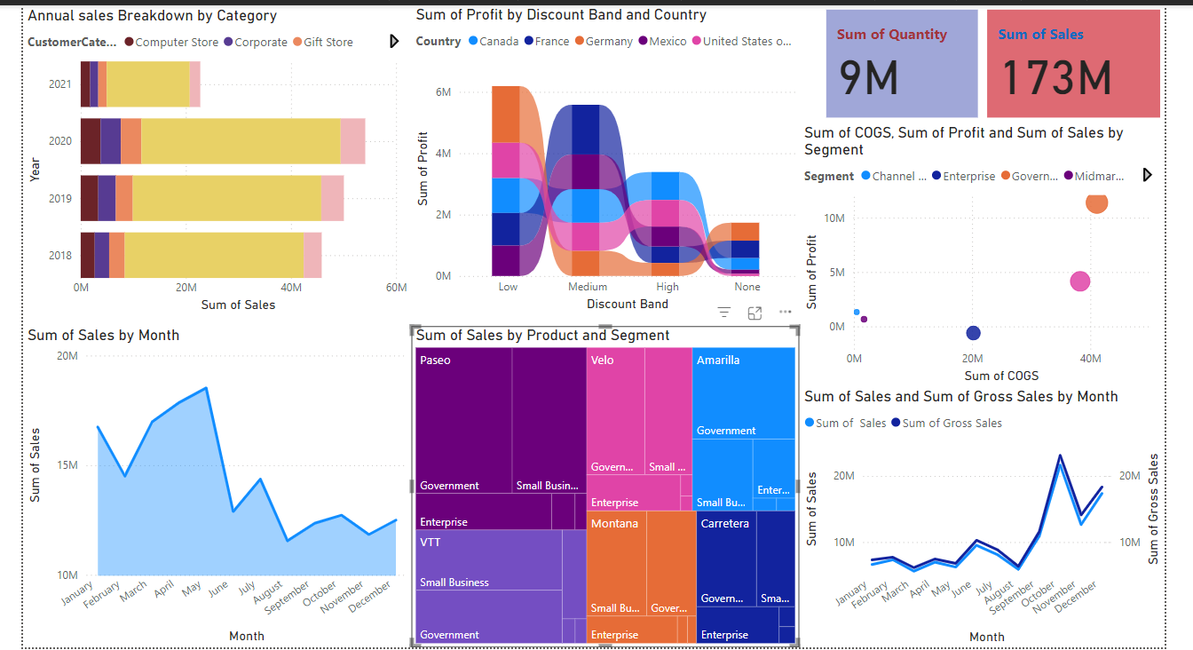
Financial Forecast Dashboard

Slide 11
Conclusion
Financial forecasting is a vital tool for strategic business growth, providing insights into revenue, profitability, and cost optimization.
Leveraging tools like Power BI ensures dynamic, actionable, and data-backed decision-making.
Prioritize high-growth revenue streams.
Optimize discounts to maintain profitability.
Prepare for seasonal demand and implement cost-saving measures.
Let’s act on these insights to drive our organization forward with confidence and achieve long-term financial stability.

Slide 12
THANK YOU

